Slide 1
Twitter Sentiment Analysis with News & Weather

Slide 2


Sowmya
Vijayakumar
Dhavala
Manjunatha

Slide 3
What’s this about?

Slide 4

Want big impact?
Use big image.

Slide 5


How’s NYC feeling today?

Slide 6



Slide 7

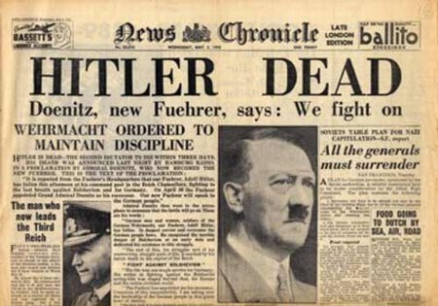

Slide 8
Data Collection

Slide 9


Tweets Collection

Slide 10


Weather Data Collection

Slide 11

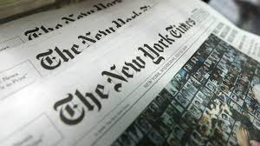


Slide 12
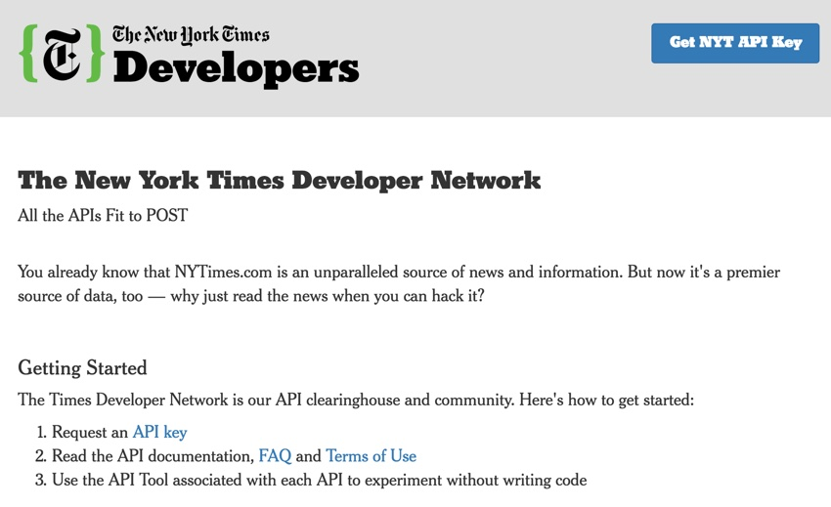
You can also split your content

Slide 13
Data Processing

Slide 14

Python Pandas
SentimentIntensityAnalyzer

Slide 15
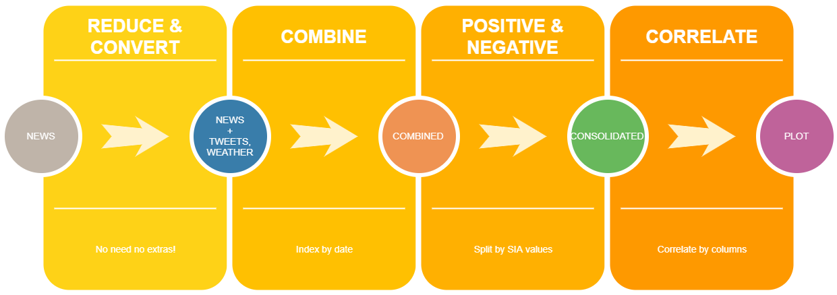

Slide 16

Thanks!
Any questions?
You can find us at:
dmanjuna@stevens.com

Slide 17
Credits
Special thanks to all the people who made and released these awesome resources for free:
Presentation template by SlidesCarnival
Photographs by Unsplash
Watercolor textures by GraphicBurguer

